Slide 1
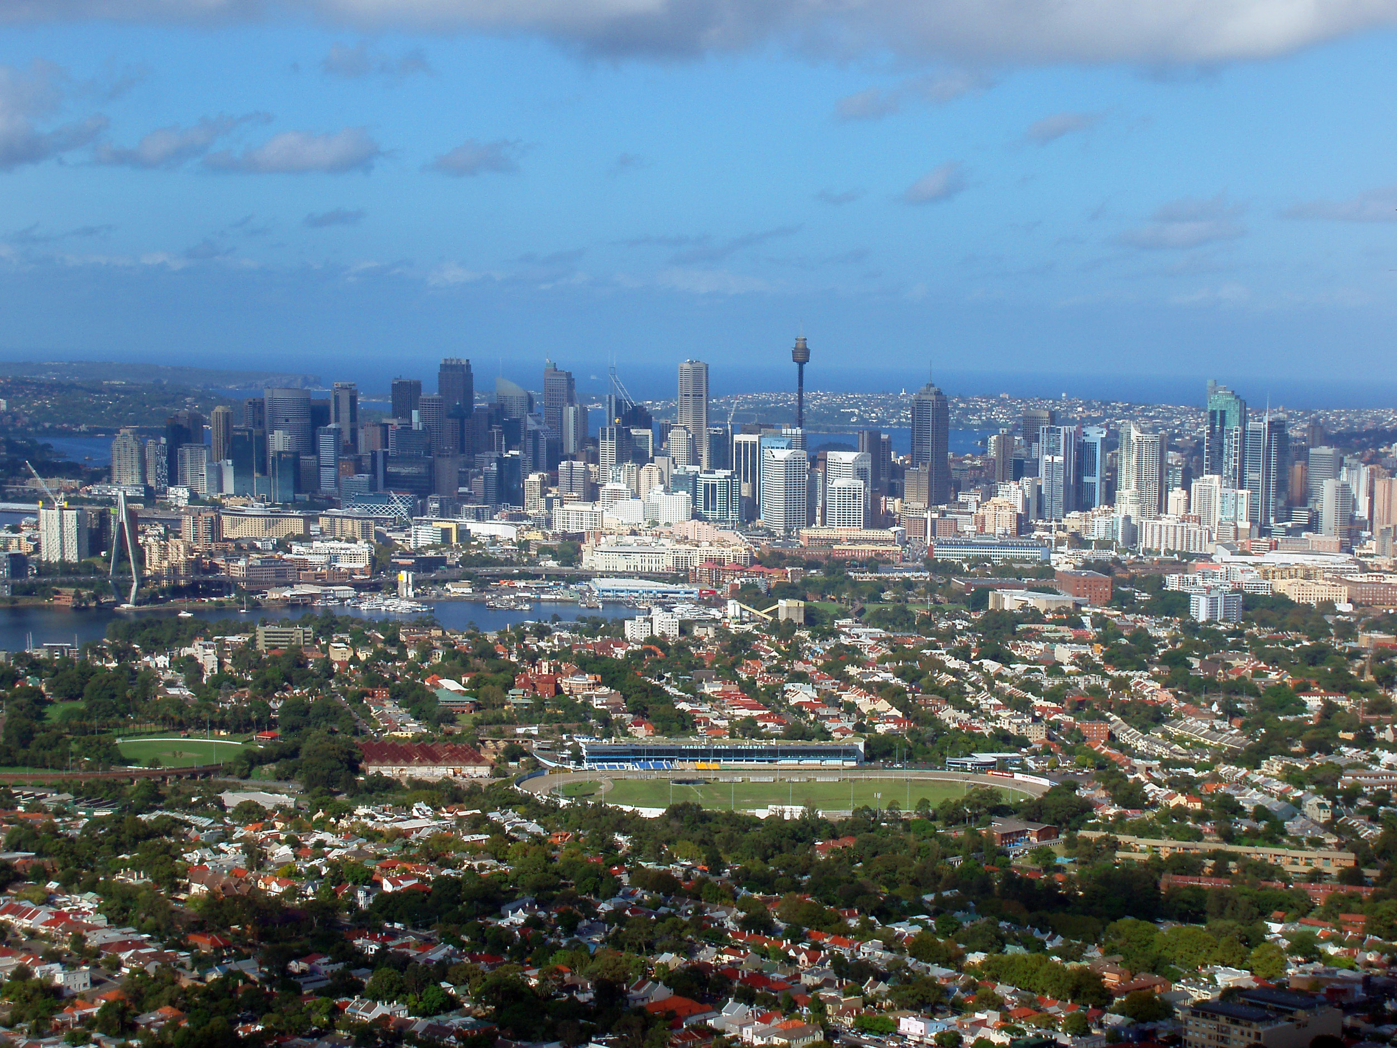
COMP2200 Data Science Group Project
Ju young Lee
Pranava Brown
Maya Assaf
Joon Hun Yang

Slide 2

An Introduction to our Project
Sydney is one of the most expensive property markets in the world.
Buying a house is considered a milestone in a regular life but now seems unattainable.

Slide 3

Our Problem Scope and Statement:
What kind of relationship exists between house sales and demographic attributes?
Does this relationship help predict future house prices for Sydney LGA's?

Slide 4

Our Data:
House sales dataset spanning 2018-2020 from NSW Communities & Justice – Sales and Renting Quarterly Reports
Estimated Resident Population (ERP) 2001-2020 data from Australia Bureau of Statistic (ABS)
Socio-Economic Indexes for Area (SEIFA) 2016 data from Australia Bureau of Statistics (ABS)
Includes 4 different indexes: Socio-Economic Disadvantage, Socio-Economic Disadvantage and Advantage, Education and Occupation, Economic Resources
Assumption: Indexes remains constant from 2016 to 2020

Slide 5
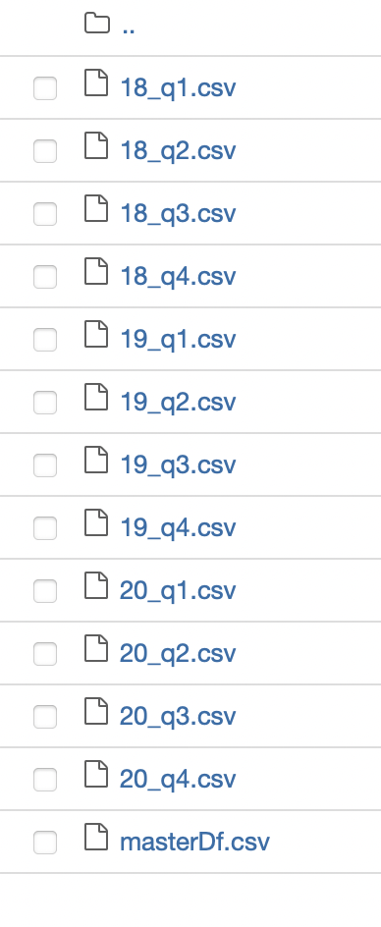
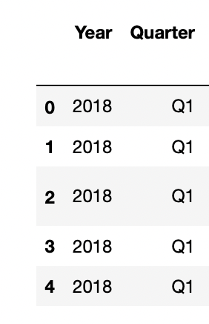
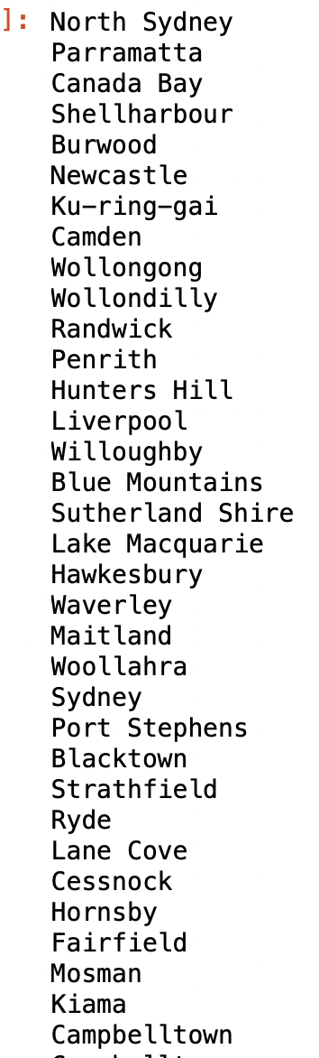
Data Preparation - Obstacles

Slide 6
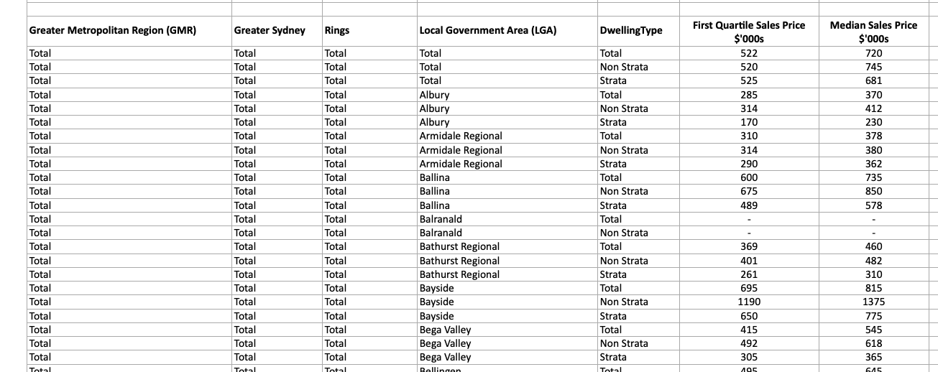
Data Preparation – More Obstacles
How the 2018-2020 data is presented (Excel files):

Slide 7
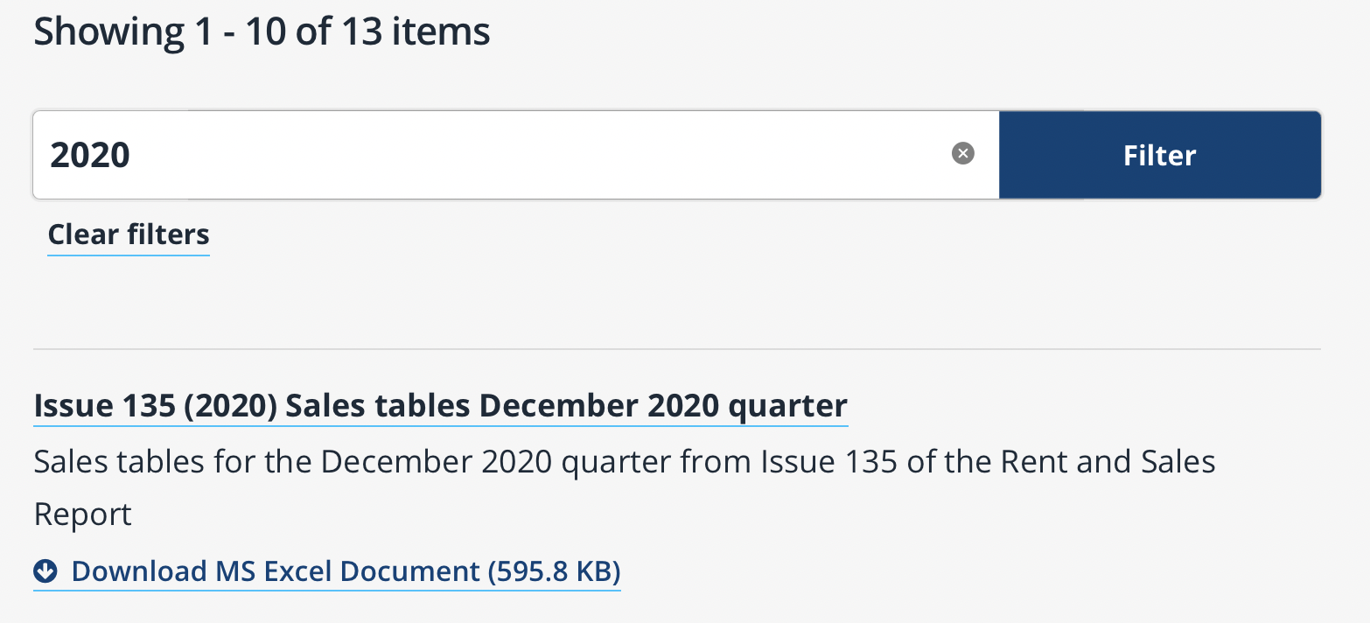
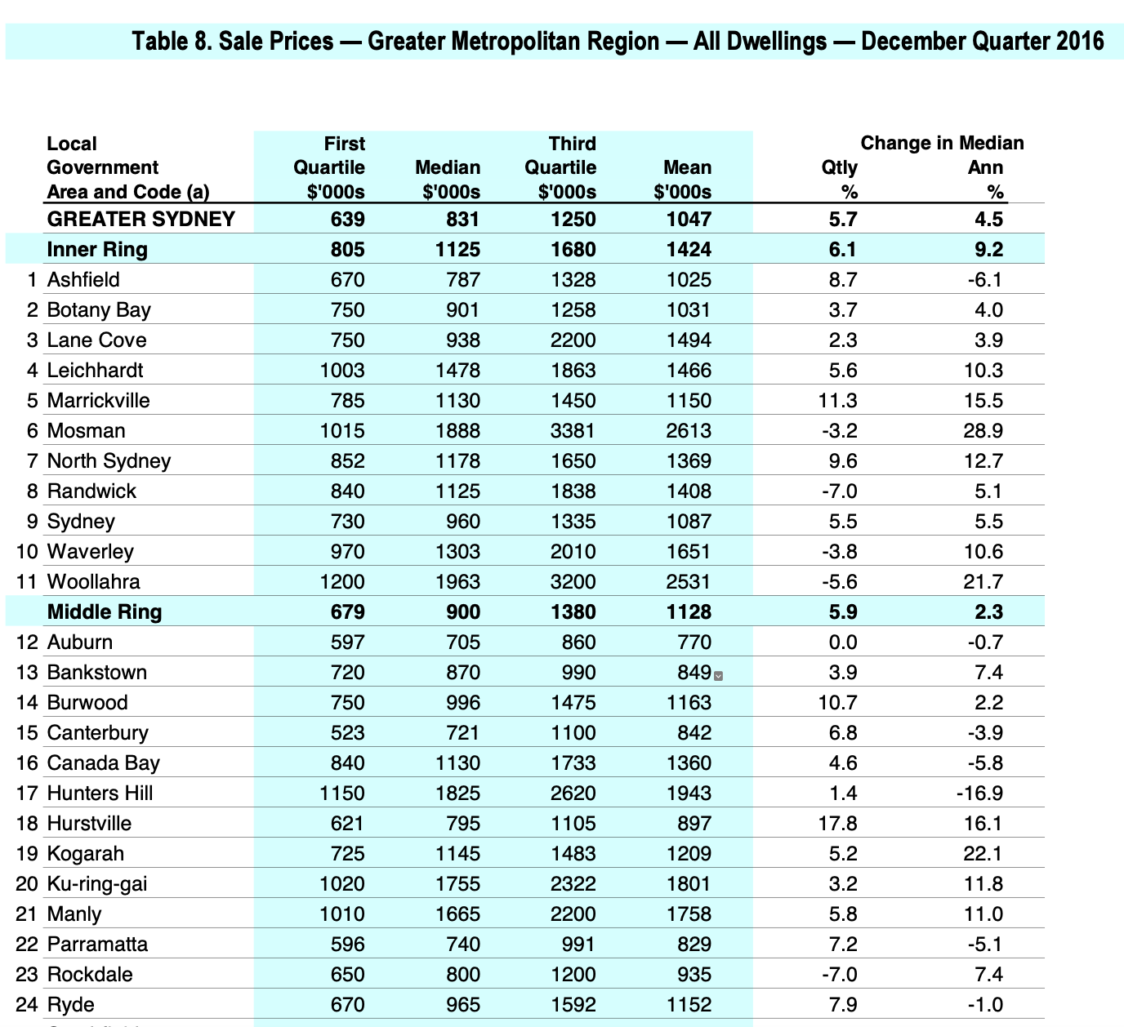
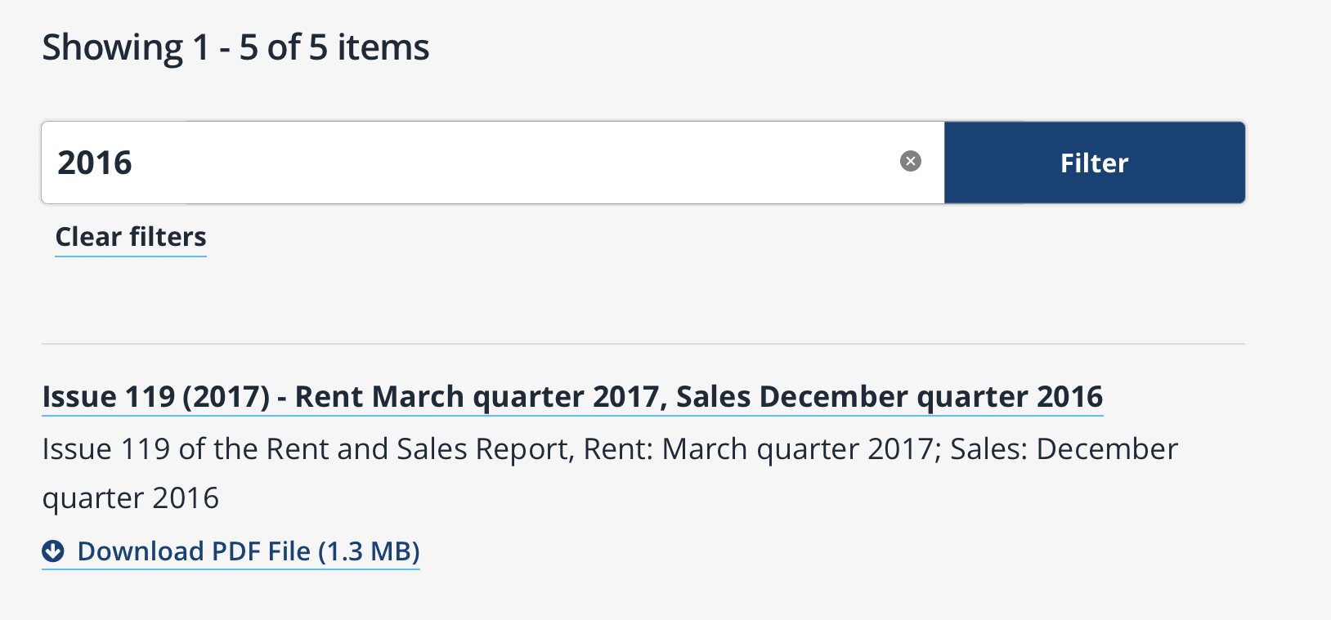
We tried to convert the PDFs into CSV files but we encountered endless formatting errors where the data became unreadable.

Slide 8
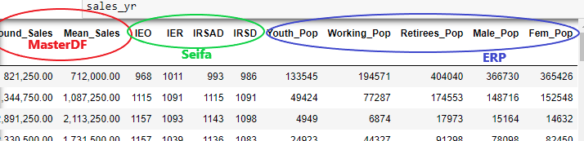
Combining multiple datasets
After the creation of the 'masterDF' file, we needed to combine other datasets that had economic and age factors to enhance the quality of analysis. We merged the other datasets into the original 'masterDF' file.

Slide 9
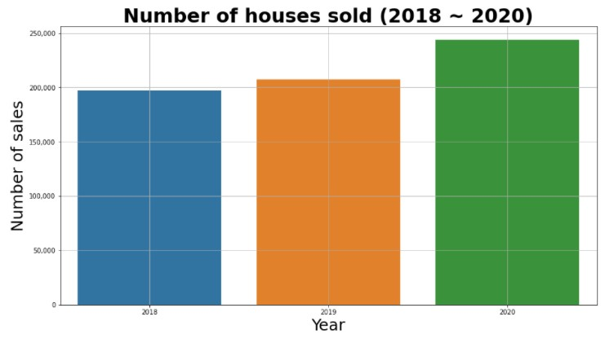
Data Visualization Techniques
Line graphs
Bar chart
Stacked bar chart
Horizontal bar chart
Correlation matrix
Pair-plot
Scatter-plot
Distribution-plot

Slide 10

Prediction Models
Simple Linear Regression
Multiple Linear Regression
Random Forest Regression

Slide 11
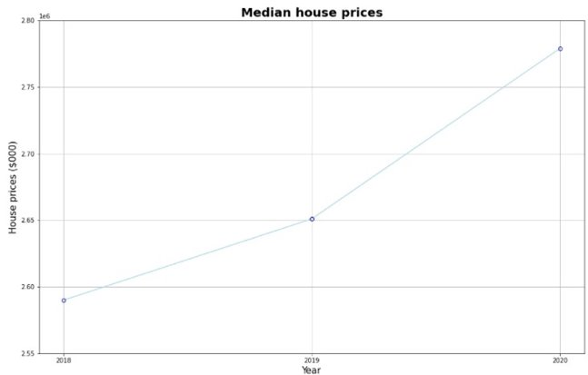
The overall housing market across NSW is growing at an increasing rate.
The median house price for the whole of NSW rose from 2.59 million to 2.78 million during 2018-2020.

Slide 12
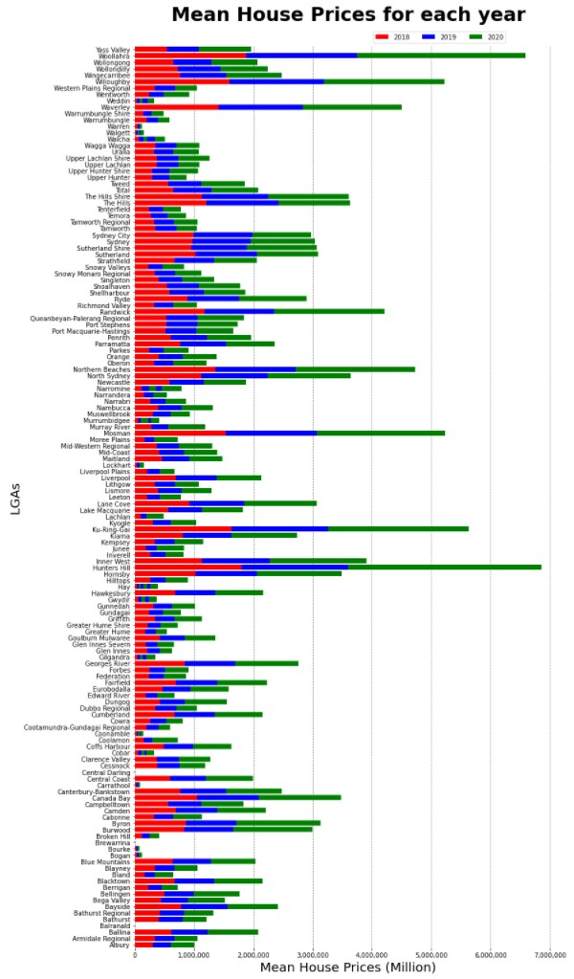
A large price range with some LGA's such as Woollhara, Hunters Hill and Willoughby having yearly median house prices easily over 1 million whereas suburbs such as Albury, Broken Hill and others a much less than 1 million.
This would mean that although house prices are rising across the state, there may be some outlier suburbs such as the ones listed above that are significantly increasing the mean house price across the state.

Slide 13

Results

Slide 14
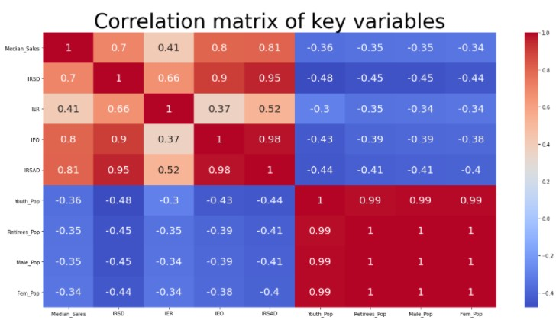
The higher the index, the higher median sales in the area are.
The relationship between IER and median sales is a lot weaker than the others and the clustering is not as dense which can indicate an unreliable trend.
LGAs with higher populations, the house prices would be lower in comparison with more exclusive areas with higher prices only NSW's richest can afford.

Slide 15
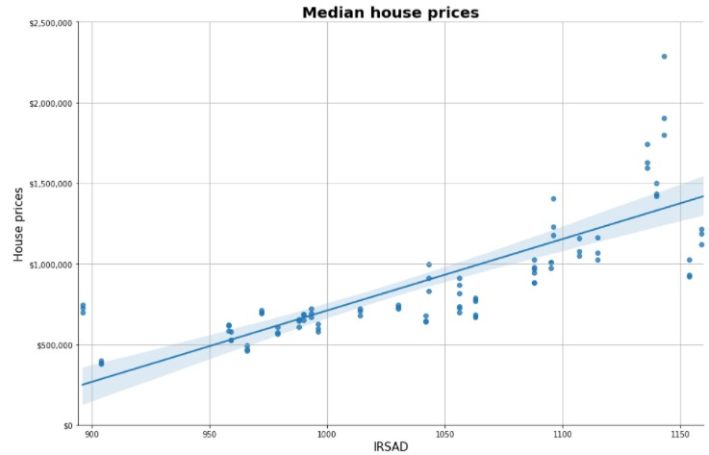
Linear Regression
Prediction error of 167,029 which is a large discrepancy in value and cannot provide investors a confident estimate of house prices.
Error this stands at 18% of the mean value ($930,102) for median sales
Strong correlation between the SEIFA data and the Median Sales shown by the R^2 value of 0.9 however this value would need to be closer to 1 to indicate a definitive and strong relationship between the variables.

Slide 16
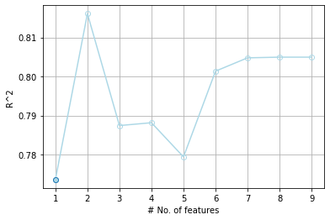
MSE corresponds to a prediction error of $162,188 which is a large discrepancy in value and cannot provide investors a confident estimate of house prices.
18% of the mean value for median sales which is a large prediction error. There is a decent correlation between the IRSAD, IEO and Median Sales shown by the R^2 value of 0.9 however this value would need to be closer to 1 to indicate a definitive and strong relationship between the variables.

Slide 17
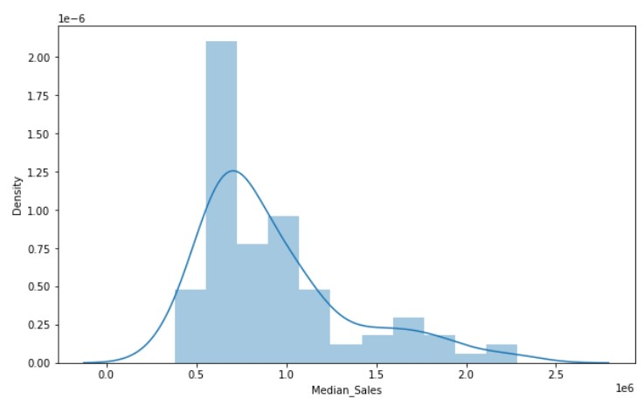
Prediction Model
(Random Forest Regression)

Slide 18
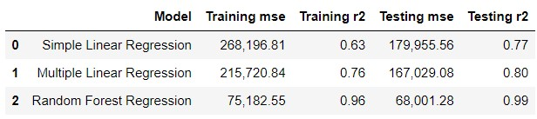
Model Comparison

Slide 19
Conclusion
- Accuracy of data we found were low due to limited data set
- Methods used are still correct in showing relationship between demographic factors and house sales and can be applied to larger data sets
- Adding new categorical factors such as if the LGA has a train station/ school etc would be interesting to improve the model through logistic regression and room for improvements on the project

